Slide 1

Phase 3 Code Demo
Team 2 Group 5
Training and Recruitment
Notes:
1

Slide 2
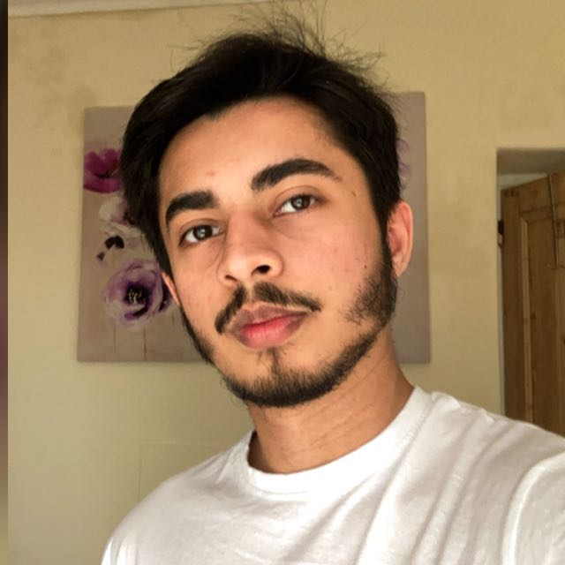
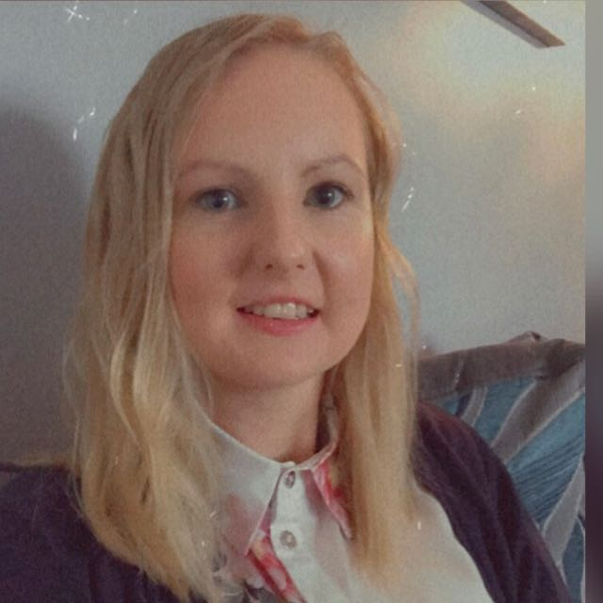

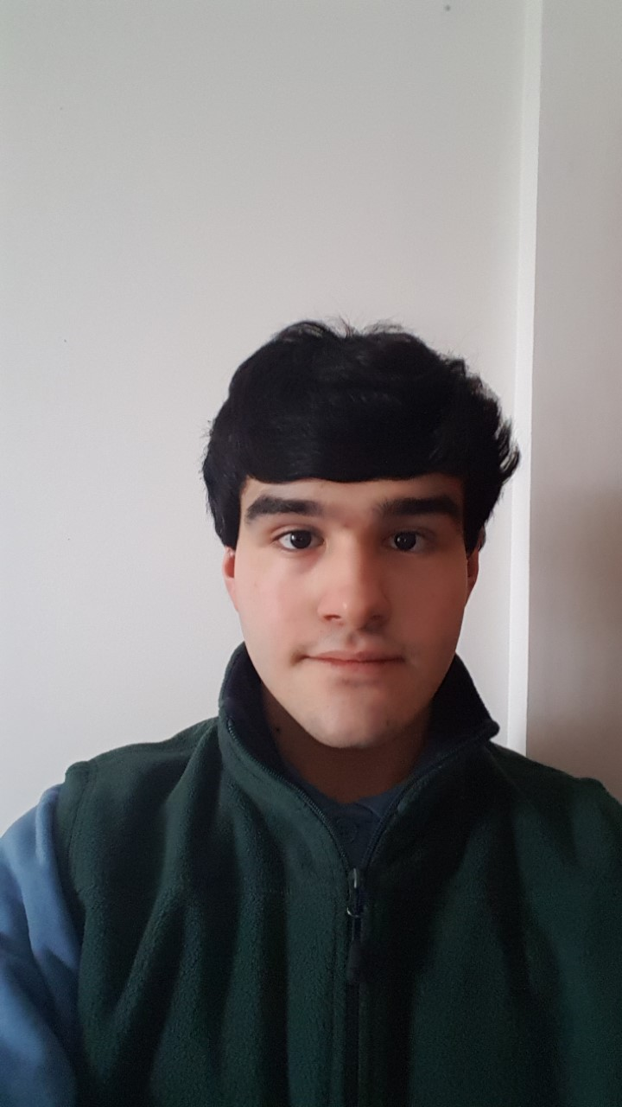
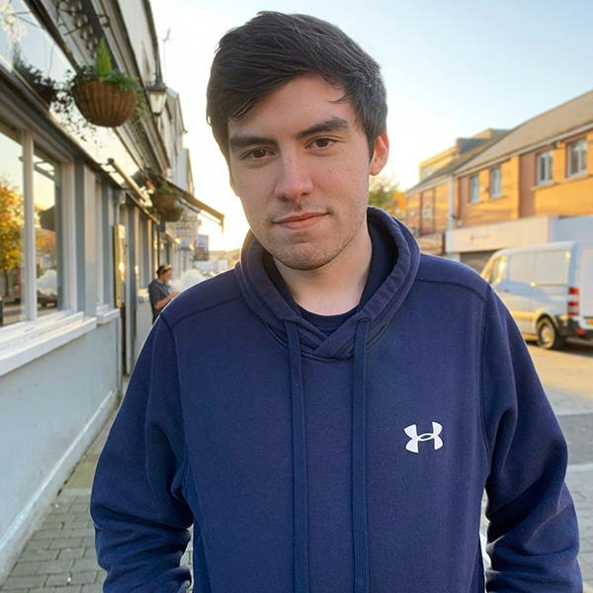

Team-5
Syed Zaki Zaidi
Kerri-Anne O’Brien
Hossam Farfour
Saleh Mohamed
Luke Waddingham
CODE REVIEWER
Head of testing
Communication supervisor
UML designer
REPORT LEAD
30010702
30014123
30008722
30001162
18030327
2
Notes:
2

Slide 3



Agenda
Topic one: UML
Topic two: CODE REVIEW
Topic three: TESTING PHASE
Topic four: REPORT
Topic five: COMMUNICATION
Syed Zaki 30010702
3
Notes:
Our agenda for this seminar is to discuss all aspect’s of the code and have a proper demonstration of it

Slide 4

UML
4
Notes:
4

Slide 5
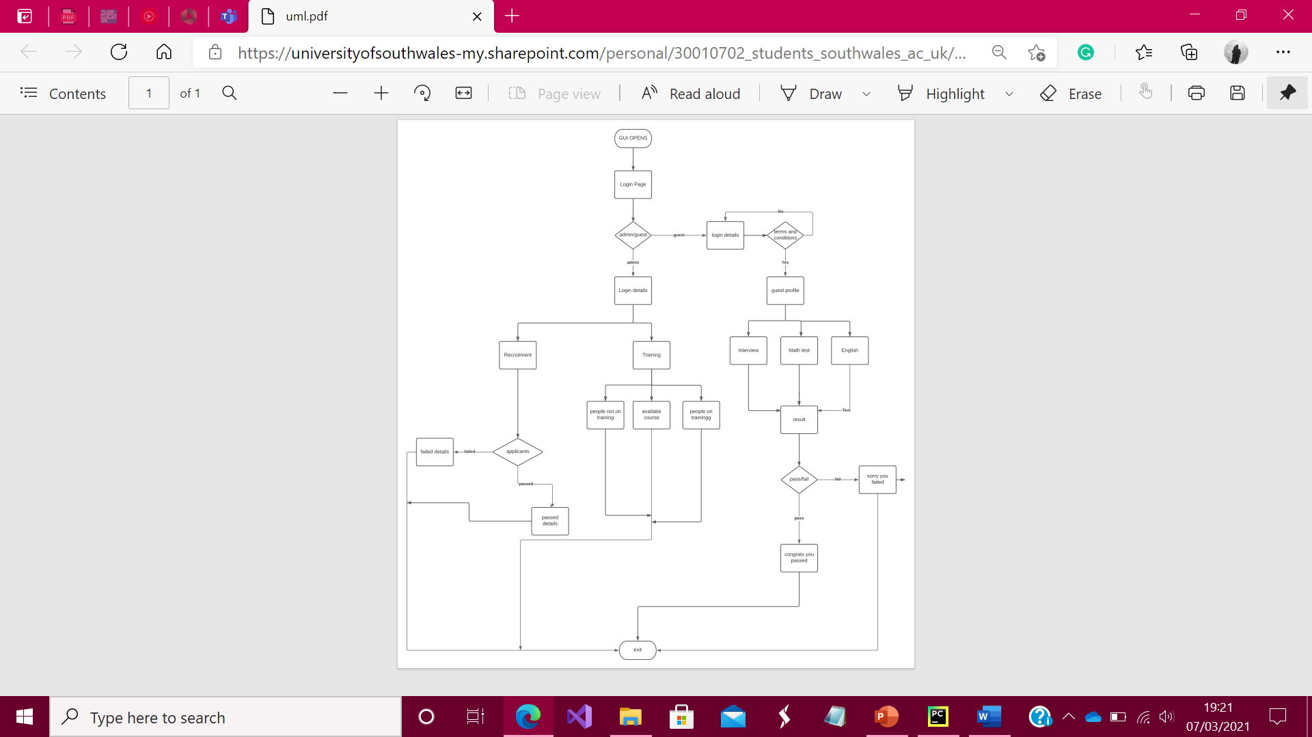
UML
An overview of our system.
These are the steps the user will take when accessing the system.
The structure of how the system works.
Saleh Mohamed 30001162
5
Notes:
5

Slide 6



UML
Our UML diagram gives a good insight as to how our system works and each
part that the user will be provided with.
The UML diagram indicates that our system is well structured and detailed
whilst also being user-friendly and easy-to-use.
Furthermore, it enables the user to have a good
grasp as to how the system works and functions and
how certain parts of it differs depending on the type of user (guest or admin) that is
using it.
Saleh Mohamad 30001162

Slide 7
Code
7
Notes:
7

Slide 8
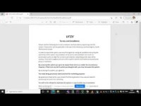
Code Demo
YOUTUBE LINLK OF THE DEMO
https://youtu.be/cxrmf7aqXHw
Video:
This video has 2 parts
1- the code demonstration of the current code
2- the future changes that will be added
Syed Zaki 30010702
8
Notes:
8

Slide 9
Testing
9
Notes:
9

Slide 10
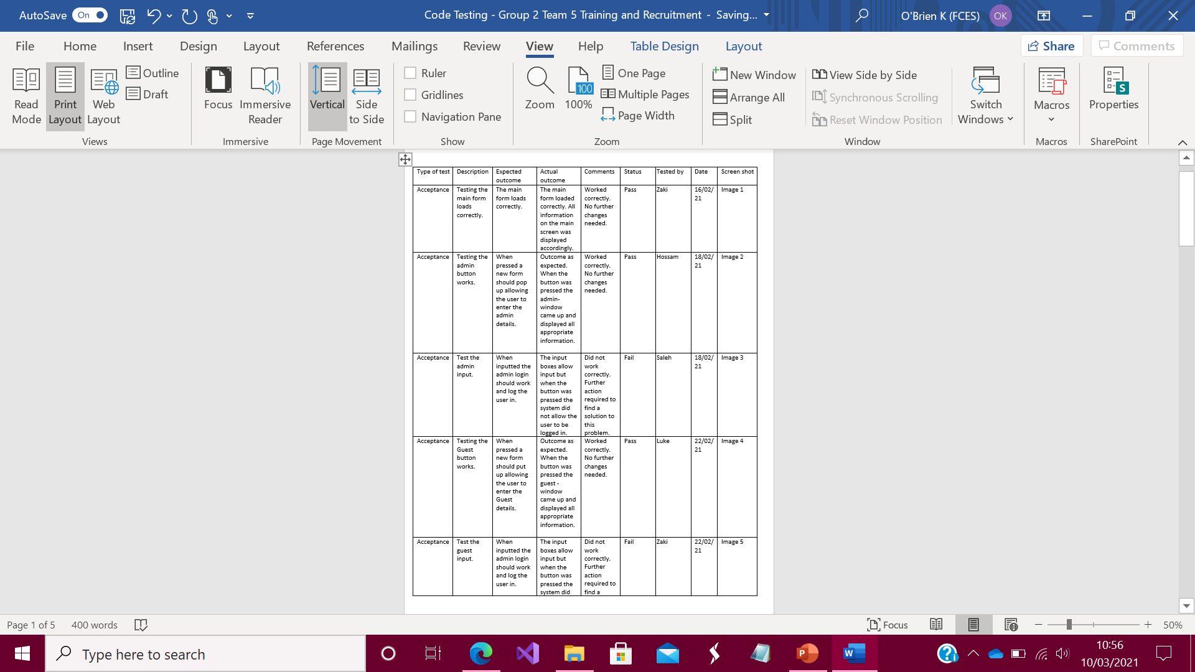
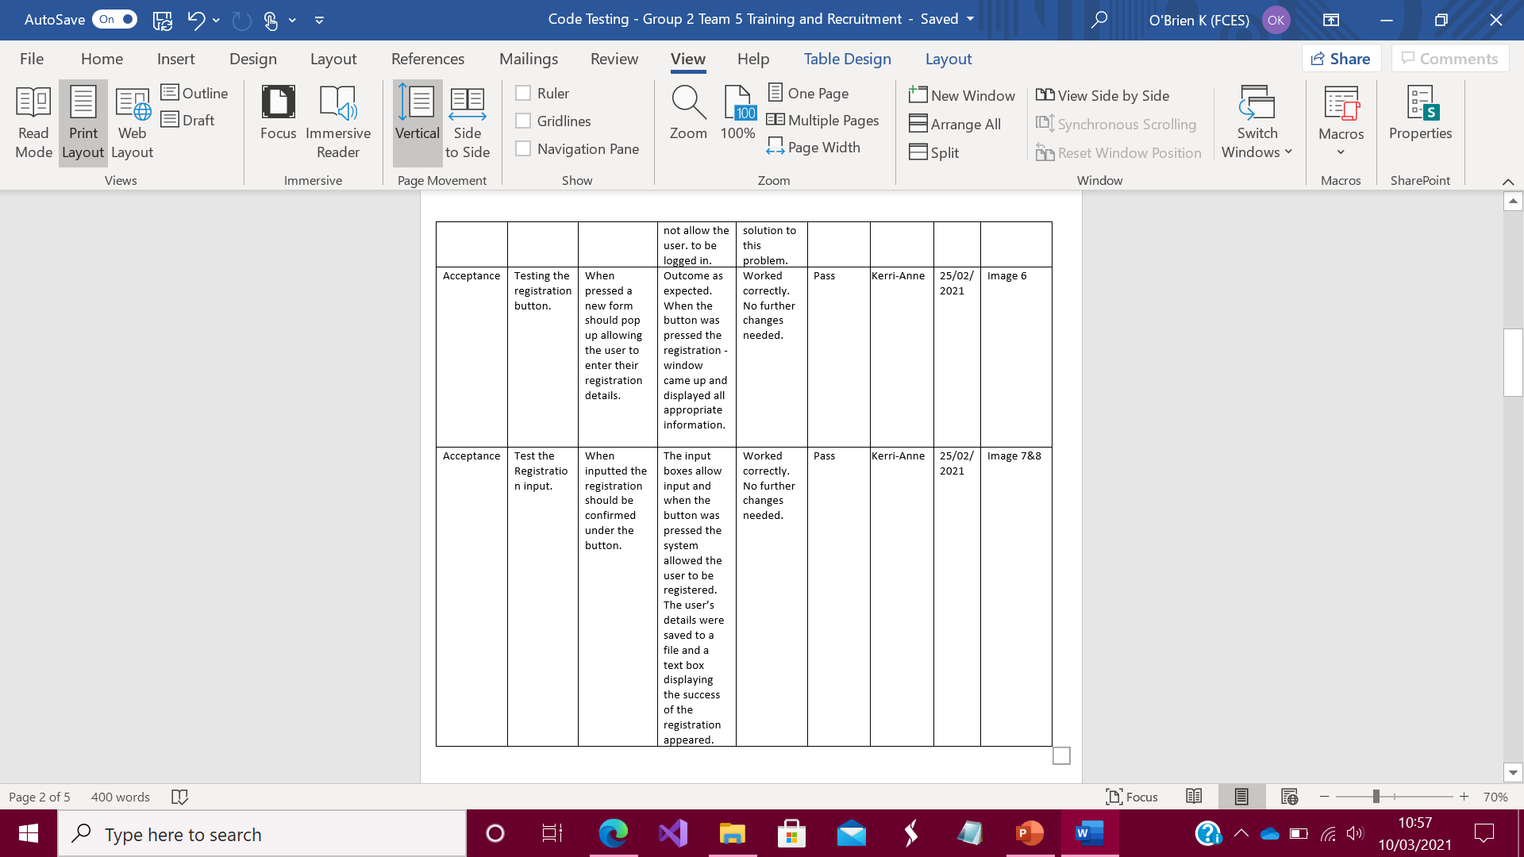
Testing
Test Document:
Type of Test
Description
Expected Outcome
Actual Outcome
Comments
Status
Tested by
Date
Screen shot
30014123 - Kerri-Anne O’Brien
Notes:
Testing was done by all team members. Each test was an acceptance test to see if it met the requirements of the program. A description was added explaining what the test covered. We wrote what we’d expect to see from the test and then what the actual outcome revealed. There is a section for comments to explain the outcome further. A section for the status tells us whether the program passed or failed the test so that we know what needs to be improved. The last few sections explain the date of the test and who the test was done by. The last box is a reference to a screen shot of the test.
10

Slide 11
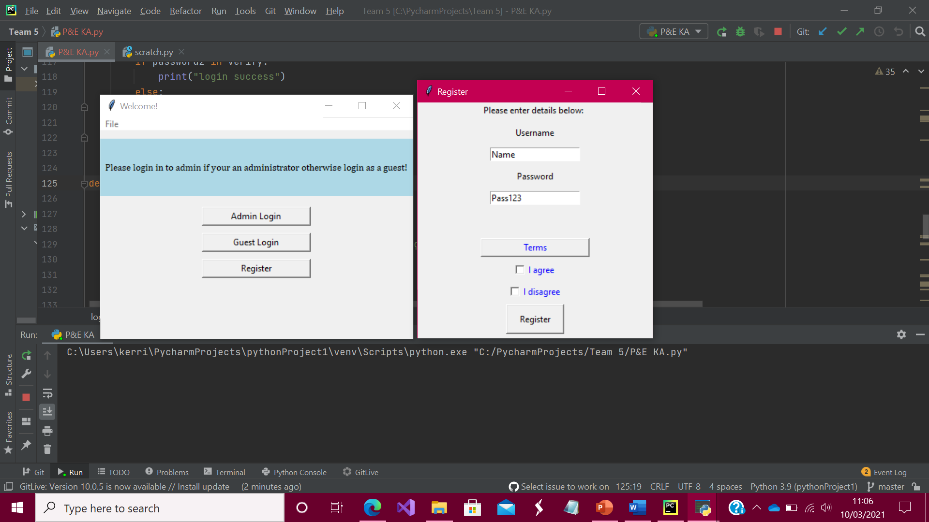
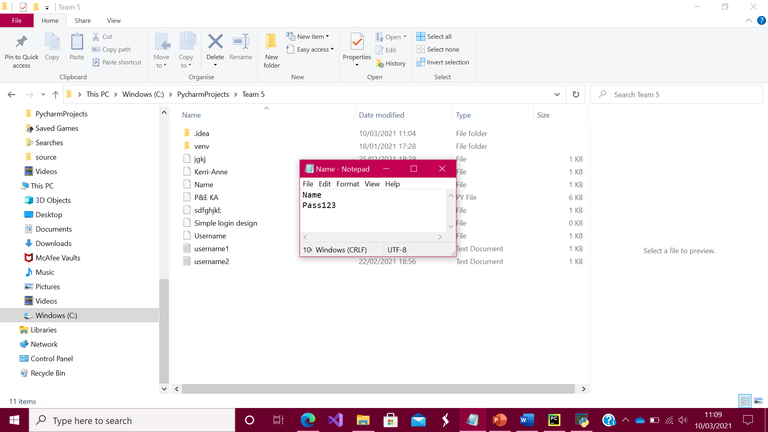
Testing
We Tested:
Screen Layout on start up
Admin button
Admin Entry
Guest button
Guest Entry
Registration button
Registration Entry
Registration details saved to text file
30014123 - Kerri-Anne O’Brien
Notes:
We tested the screen layout to make sure it loaded correctly. We tested the admin, guest and registration entry to make sure they accepted input and tested the buttons to make sure they took the input and logged the user in correctly. The last test we did included the last two bullet points on screen. As you can see from the screen shots provided registering will save the details to a file. At the moment the agree/disagree check boxes don’t work the way we want them to. Once working correctly the agree will allow the user to procced with login and the disagree will prevent log in.

Slide 12
Report
12
Notes:
12

Slide 13
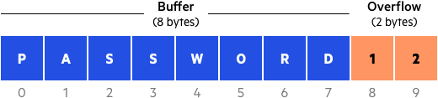
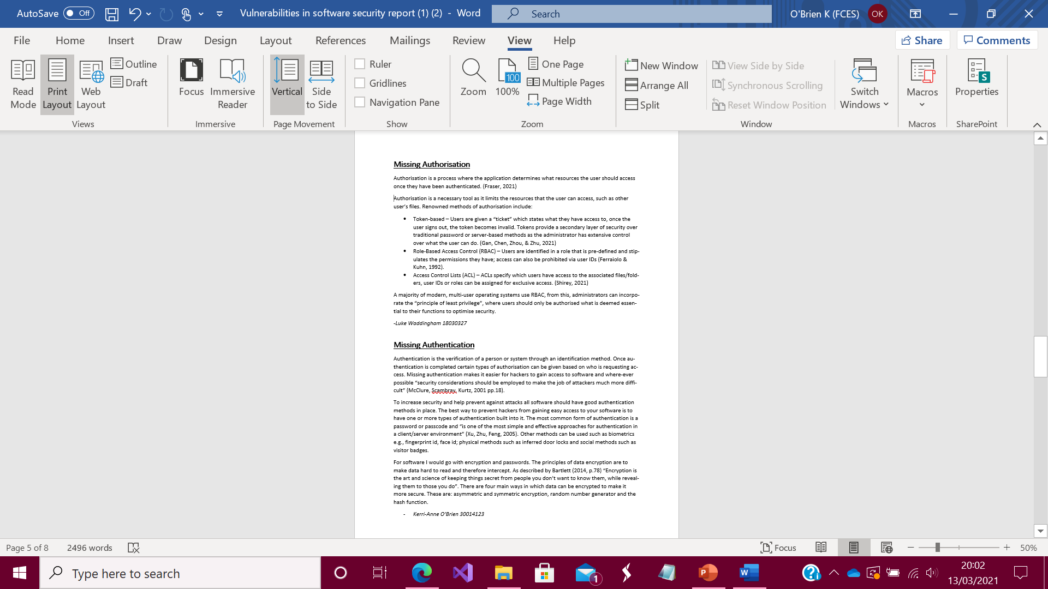
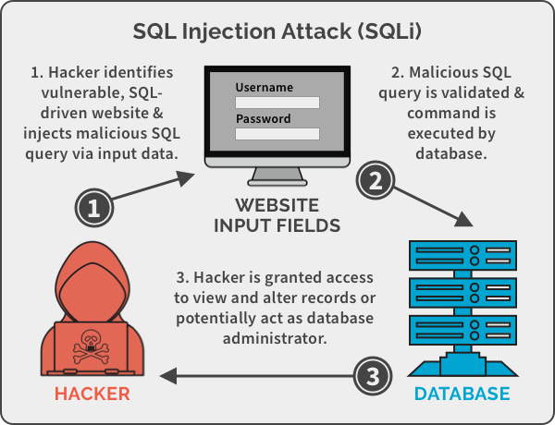
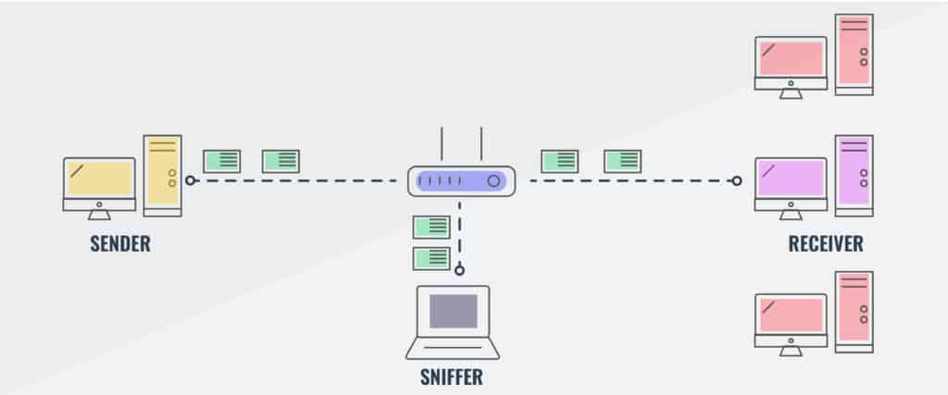
Report
We Covered:
Password Vulnerabilities
SQL injection
Buffer Overflow
Bugs
Missing Authorisation
Missing Authentication
Sniffing
Luke Waddingham 18030327
13
Notes:
Before beginning our program, we had to be aware of security risks to ensure any code that was created would be secure from the get-go.
Each member of the team researched different types of exploitation, these included:
Password vulnerabilities such as being a victim of brute force or using the same password for multiple platforms
SQL injections which are malicious inputs that can exploit databases for information or make them completely dysfunctional
Buffer overflows which are corruptions in memory addresses that can lead to incorrect results and crashes
Sniffers which monitor internet traffic
Authorisation and authentication methods such as role-based access, access control lists, passwords and dual-factor authentication.
13

Slide 14
Communication
14
Notes:
14

Slide 15
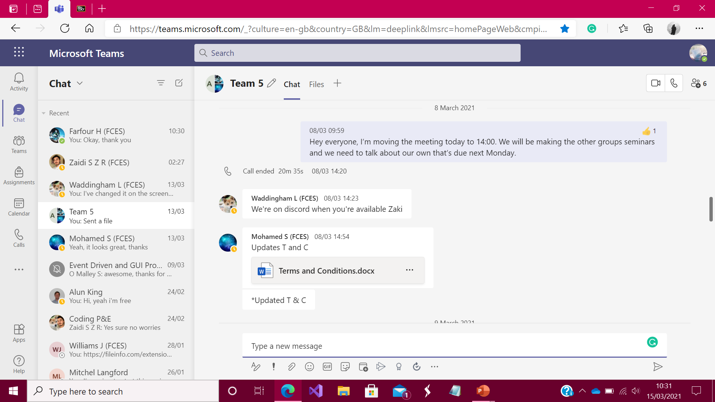
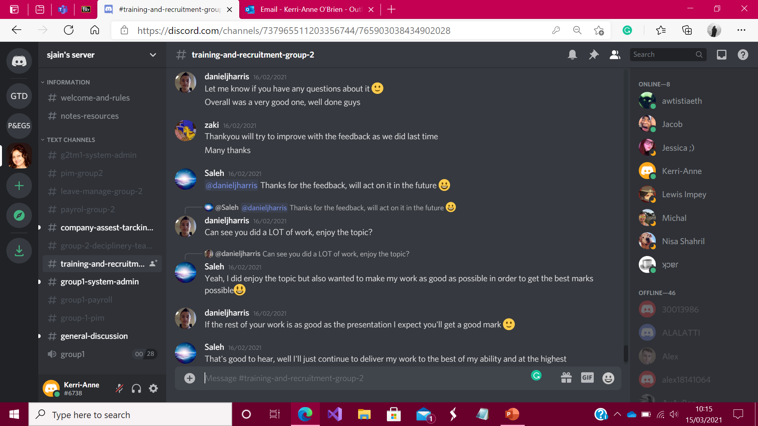
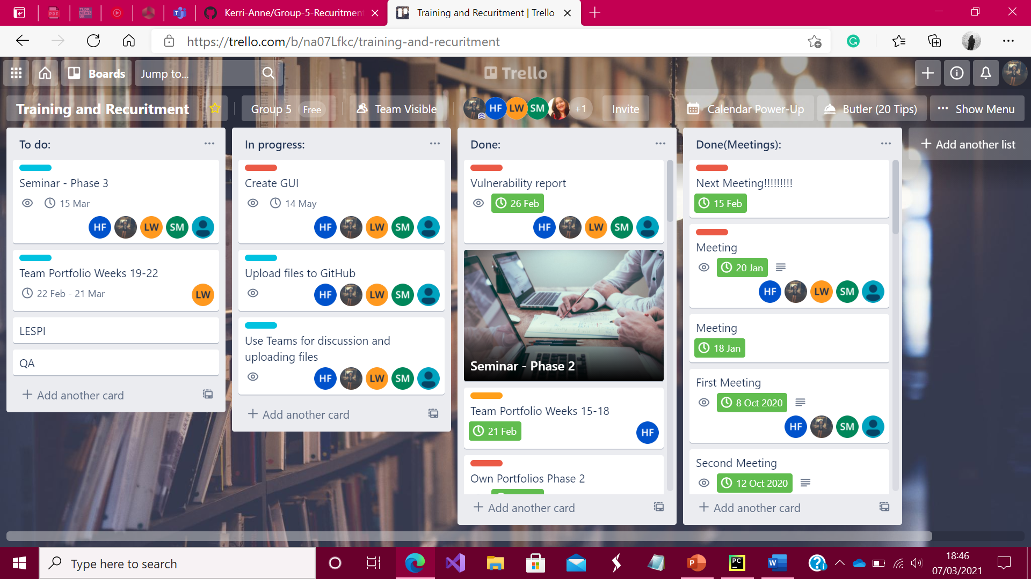
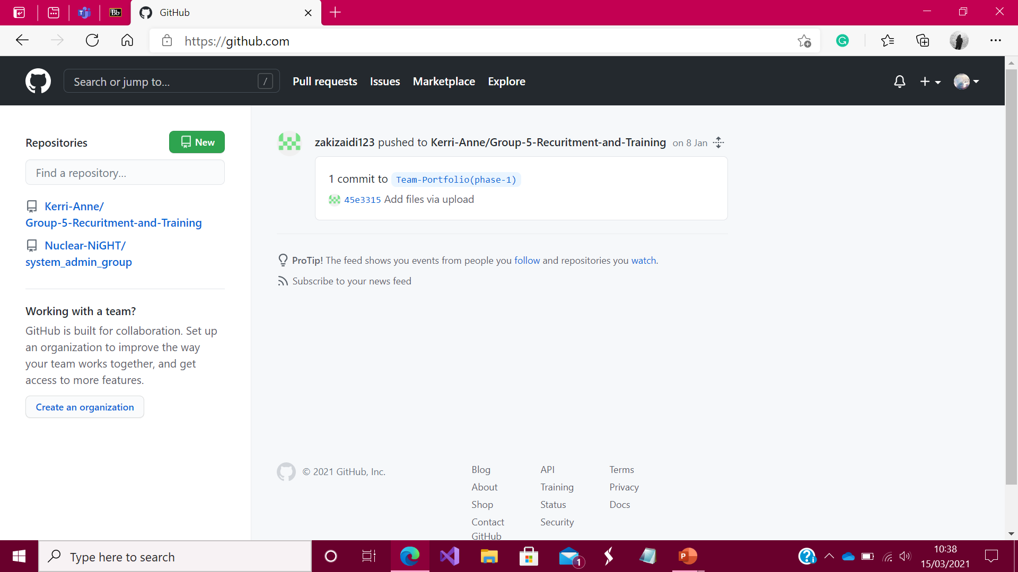
Communication
We communicated through:
Mainly used Microsoft Team in our conversations because it is so convenient to share documents and allow us uploading files during, before and after meetings.
Discord is also used to as means of fastest communication between team members and lecturer.
Trello is being used to prioritise workload as well as it is simple tools to organise tasks and track progress.
GitHub, we used GitHub because it is one of the largest coding communications between teams and wide exposure for our project.
Hossam Farfour 30008722
15
Notes:
15

Slide 16


Thank You for listening
16

